Slide 1

Cityworks UI Customization
mycityworks.force.com/s/training

Slide 2

Course Objectives
Introduce basic XML layout structure and elements
Explain best practices
Demonstrate simple XML-based customization
Demonstrate injection of HTML, CSS, and JavaScript into XML

Slide 3
XML: Extensible Markup Language
Textual data format
Utilizes rules to structure, manipulate, and describe data
Used to build user interface (UI) for Cityworks
Processed by Layout Manager to build or override UI

Slide 4
HTML: HyperText Markup Language
Used to structure and display data on web pages
Building blocks of all websites
A markup language is a set of markup tags <html></html>
Web Browser reads HTML documents and displays them

Slide 5
CSS: Cascading Style Sheets
Defines how HTML elements are displayed on a webpage
Used to format your web pages
Can be applied across multiple webpages

Slide 6
Advantages of XML
Pages can be formatted on the fly with Layout Manager
Labels, Fields, Buttons, and Panels are customizable
Can be combined easily with HTML, CSS, and JavaScript
Shallow learning curve—anyone can do it!

Slide 7
XML Terminology
Characters in a string are building blocks of XML
Elements are the XML sentence equivalent
Each element starts and ends with a tag <></>
Elements contain strings known as content and markups

Slide 8
XML Terminology
Child Elements are subsets of elements
These fall within element start and end tags <></>
They typically contribute to modifying the main element
Tags are used to start and end elements.
<start tag>
</end tag>
<empty event tag />

Slide 9
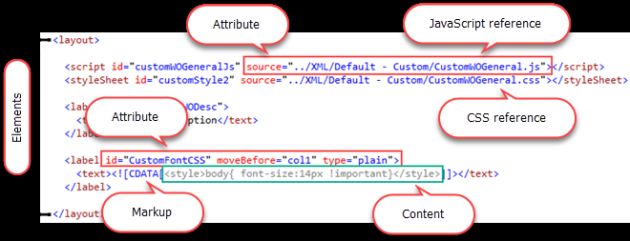
XML Terminology
Markup is a string, between tags, contained in <>, [ ], &, ;
Content is a string between tags, that isn’t Markup
Attributes are strings that modify certain features of the element.

Slide 10
XML File Structure
XML Declaration: <?xml version="1.0" encoding="utf-8" ?>
All XML files must begin with a declaration
Declaration identifies XML version and character encoding
Do not alter or remove the XML Declaration

Slide 11
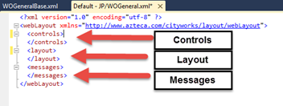
XML File Structure (Continued)
<webLayout xmlns="http://www.azteca.com/cityworks/layout/webLayout">
This line flags file as Cityworks Layout Manager XML file
Line also identifies file as a "webLayout"

Slide 12
XML Controls
Controls of XML files define each control element
Button: Perform a specific action on the page
Control: Include buttons, grids, fields, drop-down list and combo boxes, calendars, checkboxes, and radio buttons
Grid: Contain information-specific tables and lists
Zone: Not yet enabled; will be implemented in future Server AMS releases

Slide 13
XML Controls (continued)
Every element has an Id attribute used to identify it
Changing an element’s Id will cause an error
Cityworks Server Control Id Naming conventions:
“grd___” = grid
“chk___”= check box
“cbo___” = drop box
“txt___” = text field
“btn___” = button
“cal___” = calendar

Slide 14
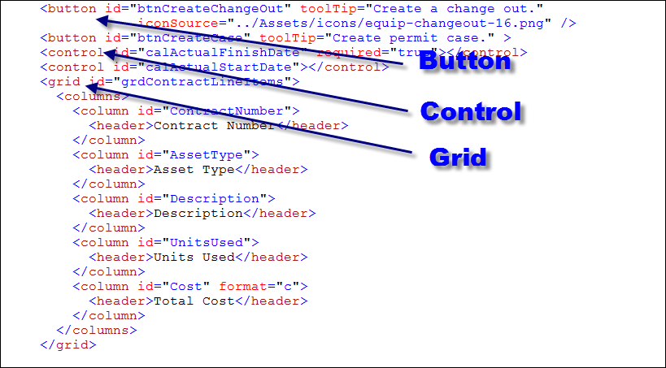
XML Controls (continued)

Slide 15
Layout
The Layout section takes controls and arranges them
<zone>: Can be thought of as the page
Each page is divided into <column>, <panel>, <row>
Columns and panels always have Id attributes
Rows can have an index attribute
Index attribute identifies position of rows in a panel

Slide 16
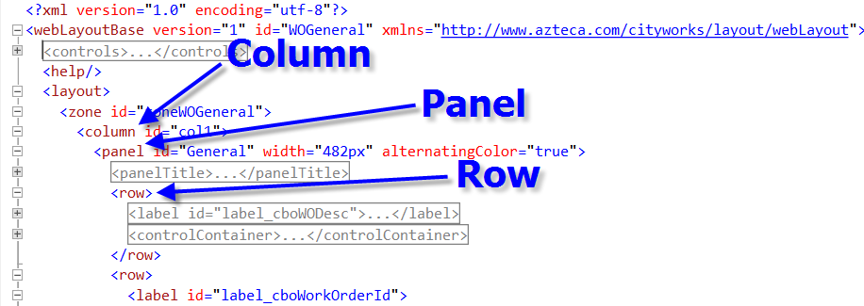
Layout

Slide 17
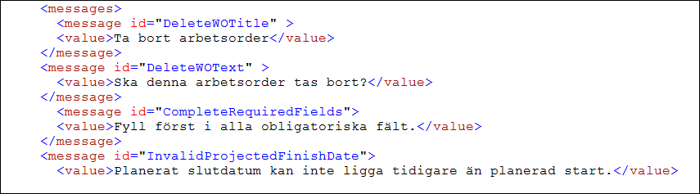
Messages
<Messages> are used for internationalization and to customize your GUI
Displayed text can be specified in multiple languages

Slide 18
Layout Manager (LM)
A custom GUI-rendering engine integrated into Cityworks
Responsible for roughly 90% of Cityworks UI
Users can not open and interact directly with LM
Users interact with LM through formatted XML files
Each time a page loads, LM dynamically creates the GUI

Slide 19
Server AMS Page Structure
Each page has 3 columns, each with one or more panels
Panels must contain a row to display in a column
Each row must have one control to display in a panel
No limit to number of rows on panel or controls in a row

Slide 20
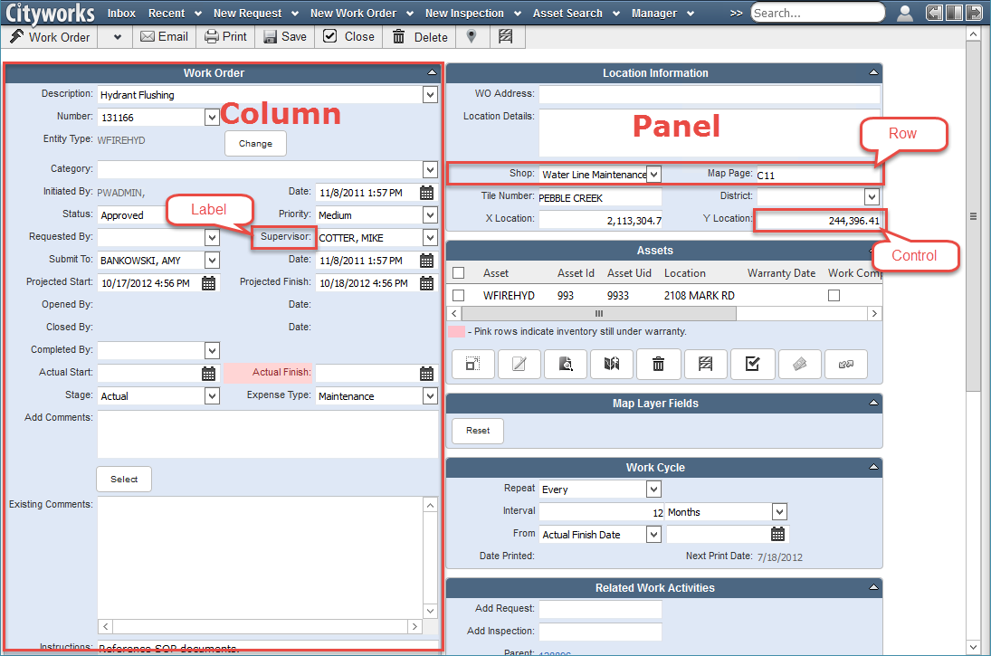
Server AMS Page Structure

Slide 21
Locating XML Files
XML files are located in the install directory
“…CWAdmin\Sites\<site name>\Website\Xml”
“Base” files should not be edited directly
“Non-Base” files can be modified directly
Always create a backup copy of non-Base files before editing

Slide 22
Editing XML
When editing XML using software with IntelliSense is recommended:
Visual Web Developer
Visual Studio
oXygen
Komodo Edit
Notepad++
Settings -> Preferences -> Auto-Completion -> then check the box next to enable auto-completion on each input.

Slide 23

Questions?

